Slide 1
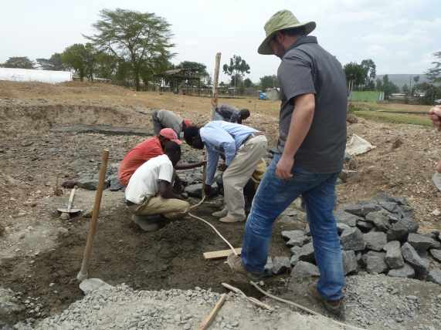
CONSTRUCTION OF A DTF
CRITICAL STAGES

Slide 2

STAGES OF CONSTRUCTION
1. Site identification, acquisition and securing
2. Procurement of material and equipment
3. Setting out of structures
4. Construction
5. Testing of works
6. Commissioning

Slide 3



1. Site identification, acquisition, securing
Appropriate slopes/gradient and dimensions
Legal documents
Fence to restrict access
2. Procurement of materials and equipment
Construction material of right quality
Proper equipment for construction
Appropriate storage of material

Slide 4
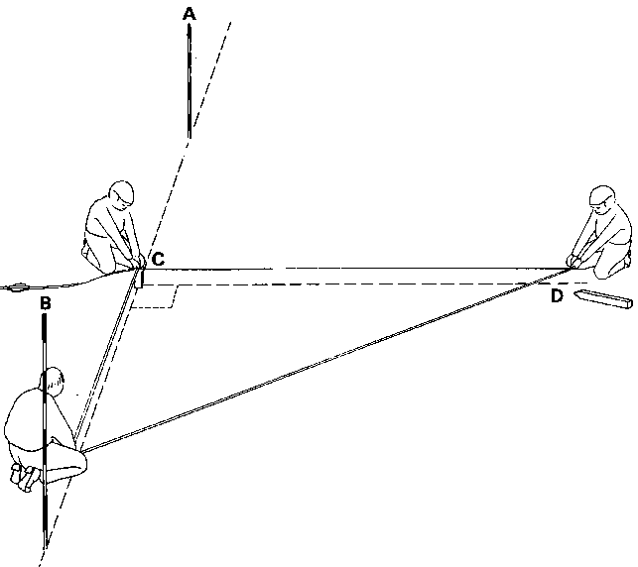
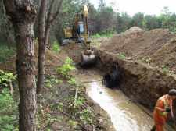
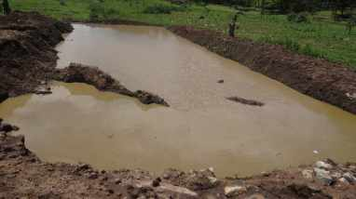
3. Setting out of structures
Site clearance
Correct position of modules (dimension and level)
4. Construction
Excavation for foundation
Correct dimension and level (avoid over-excavation)
Free from water (at least 4 hours after concrete is placed)

Slide 5
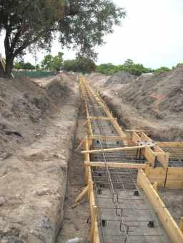
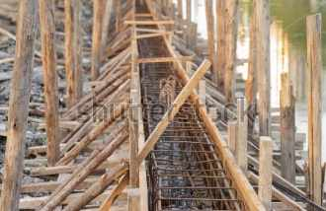

Formwork
Respected minimum period before removal
Cleaned and dressed with clear oil before fixing
Tight joints
Holes and spaces tightly sealed

Slide 6
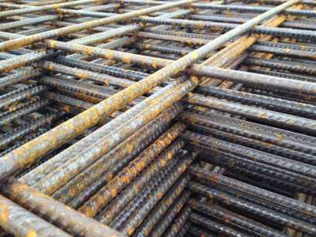

Reinforcement
Reinforcement bars (beams and columns): right size, length and shape (see bar bending schedule)
BRC mesh (ground slab) : right spacing and size
No movement during concrete placing
Should not touch the formwork
BRC Mesh A142 : spacing 200mm size 6 mm
Y10 reinforcement bar: size

Slide 7
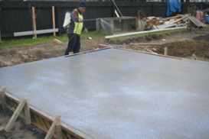
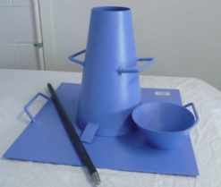
Concrete work
Correct ratio of cement/sand/aggregate (volumetric boxes)
Mix of concrete with clean water
Slump test (cone) to be done at each mixing of concrete to test the correct amount of water
Smooth transport to prevent adulteration, segregation and loss of ingredients
Pouring to be done as close as possible to final position
Curing process start 4h after concrete placing and last at least 7 consecutive days
During the first 4h, exposed concrete surface is protected with impermeable sheeting
Concrete class 25
(1 : 1.5 : 3)

Slide 8
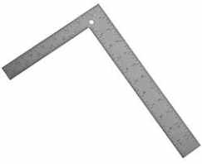
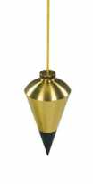
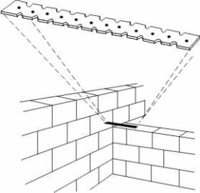
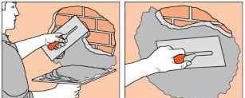
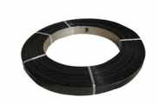
Masonry works
Walls need to be straight, square and plumb (basic tools: square and plumb bob)
Walls should be plastered (with water proof additive) and painted where specified
Hoop iron shall be fixed every other course of bricks
All masonry work must be plumb and square

Slide 9
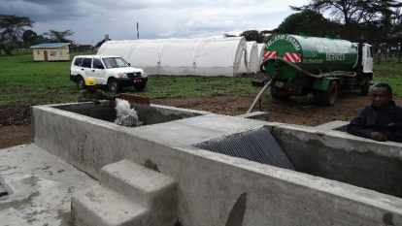
5. Testing of works
Flooring, doors, windows, ironmongery, roofing
Doors and windows shall be procured in accordance to their sizes and type.
All the doors and windows ironmongery including locks, stays, jambs and wall passes must be of the right quality.
Roofing must be done using treated timber
Each tank should be filled with water (drinking water or from a water body) for at least 48H

Slide 10
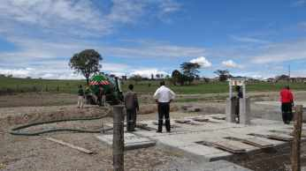
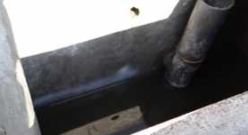
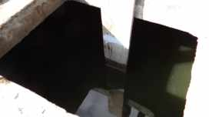
The reference water level should be measured after half a day to take into account the soaking effect of the wall
The chambers of the ABR should be filled all together progressively to avoid putting pressure on the walls
6. Commissioning and Handing over
Once all necessary repairs have been done and the facility is considered operational, the certificate of completion can be signed. The DTF can be handed over to the WSP and commissioned with septage or wastewater

